Slide 1
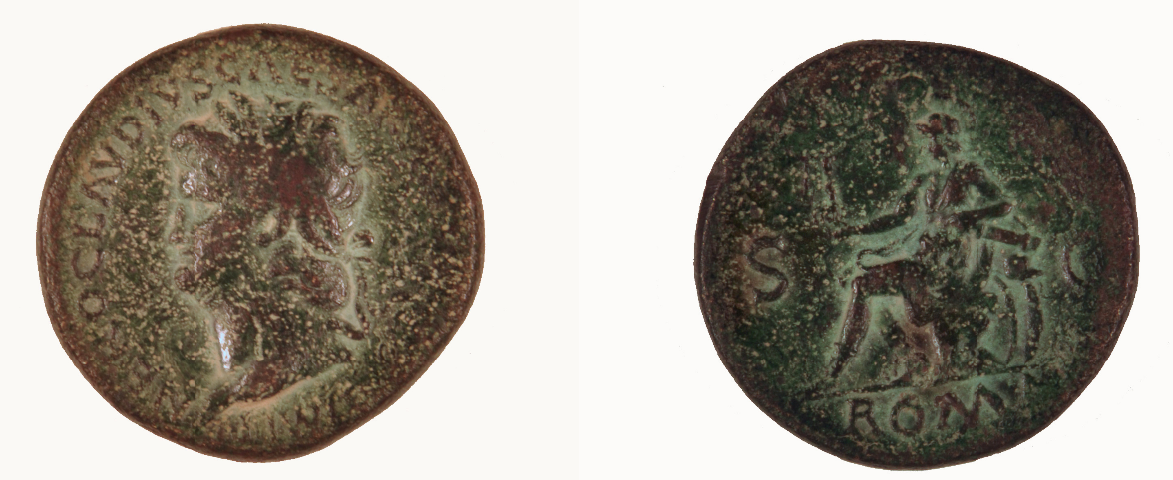
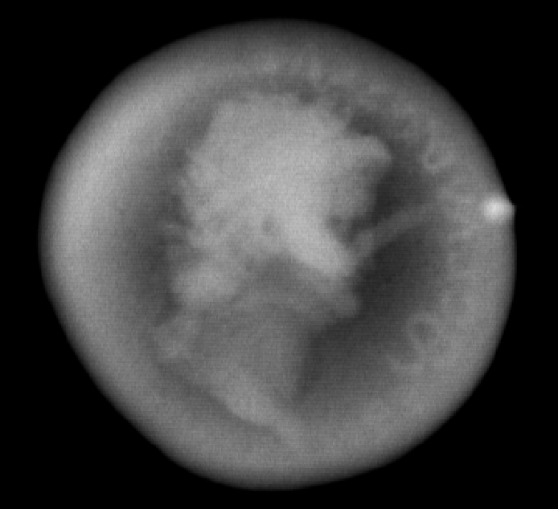
Roman Bronze Sestertius of Nero, ca. 60 CE. Accession #: 1997.1.68
(traditional 2-D CR radiograph read by the Carestream Directview reader)
1997.1.68

Slide 2
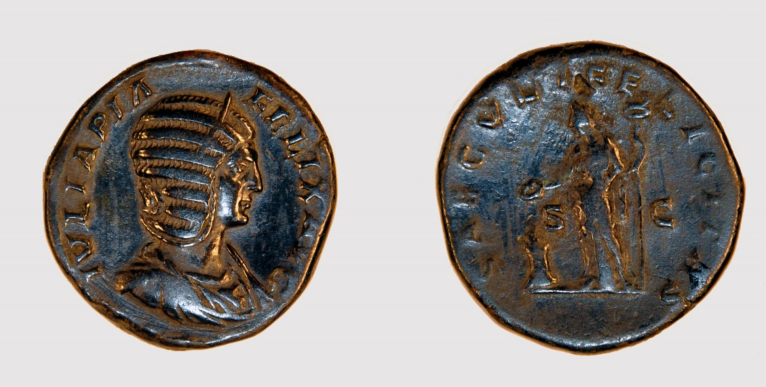
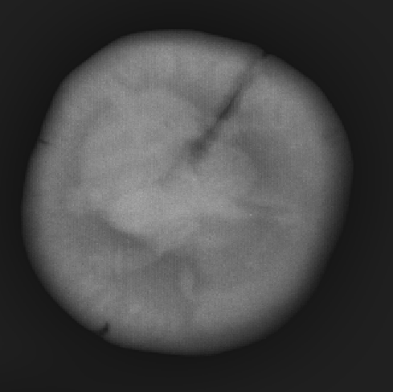
Roman Bronze Sestertius of Julia Mamaea, ca. 235, Accession # 1997.1.80
(traditional 2-D CR radiograph read by the CareStream Directview reader)
1997.1.80

Slide 3
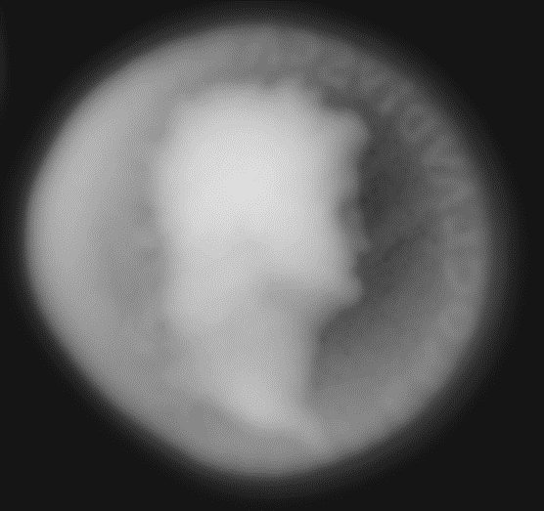
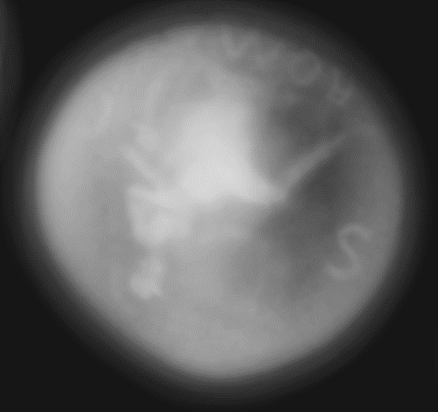
Traditional 2-D CR radiograph for comparison
Digitome images at the level of the coin faces. Bronze Sestertius of Nero (1997.1.68)

Slide 4
Traveling through the Sestertius of Nero (1997.1.68) with Digitome. Note that the ending face is inverted because we are looking through the coin to the back. Each frame of this scan represents a vertical movement 0.002” upwards from the previous one.

Slide 5
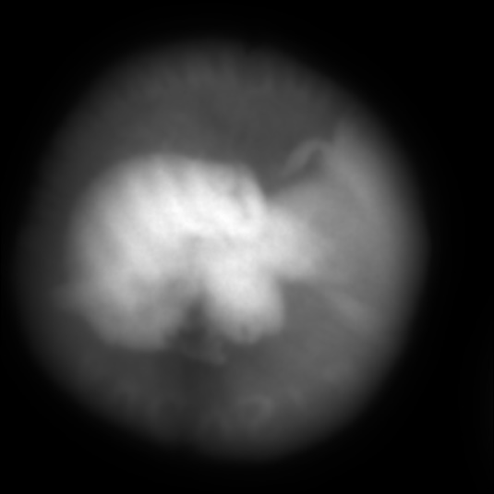
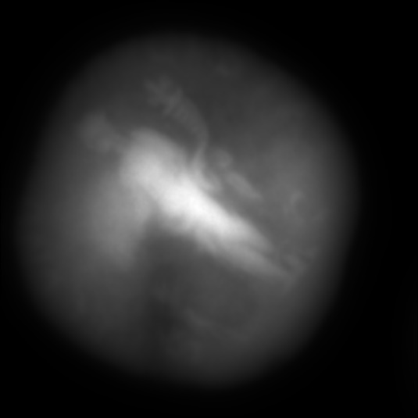
Traditional 2-D CR Radiograph for comparison
Digitome images at the level of the coin faces. Bronze Sestertius of Julia Mamaea (1997.1.80)

Slide 6
Traveling through the coin with Digitome. As in the other scan, each frame represents a 0.002” vertical movement. Note that the ending face is inverted because we are looking through the coin to the back.
A void appears in the middle of the coin but is not in focus on either face. This indicates that it is an internal void that can only be seen with x-rays, not with the naked eye outside of the coin.

Slide 7
Radiographs of roman coins using Digitome® volumetric technology and edge detection techniques

Slide 8
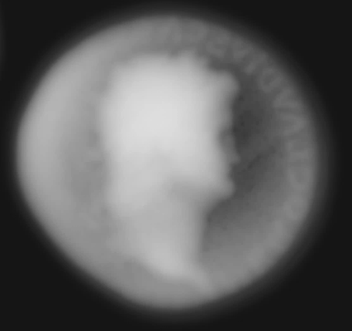
Roman Bronze Sestertius of Nero, ca. 60 CE. Accession #: 1997.1.68
Photograph of coin
Radiograph from Digitome® scan of coin
Radiograph from Digitome® scan of coin, after using edge detection technology and an extended depth of field plugin

Slide 9
Scan through the coin. The tails side is upside down, but this allows the heads side, which has more interesting letters and features, to be upright.

Slide 10
Click to fade-in Digitome® radiograph enhanced by edge detection and extended depth of field

Slide 11
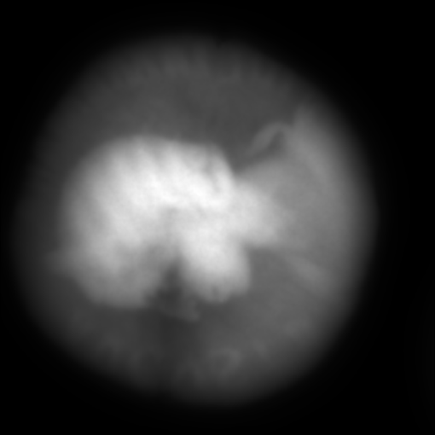
Bronze Sestertius of Julia Mamaea (1997.1.80)
Photograph of coin
Radiograph from Digitome® scan of coin
Radiograph from Digitome® scan of coin, after using edge detection technology and an extended depth of field plugin

Slide 12
Scan through the coin. As before, the tails side is flipped horizontally, but this is inescapable if we want the heads side to be upright.

Slide 13
Click to fade-in Digitome® radiograph enhanced by edge detection and extended depth of field

Slide 14
Experimenting with a New Type of Edge Detection
Using the Roman Bronze Sestertius of Nero, ca. 60 CE. Accession #: 1997.1.68
Photograph of Sesterius
Digitome Radiograph of Sesterius
Digitome Radiograph of Sestertius, using addition-based edge detection and an EDF plugin
Digitome Radiograph of Sestertius, using multiplication-based edge detection and an EDF plugin

Slide 15
Addition-based
Multiplication-based

Slide 16
Experimenting with a New Type of Edge Detection
Using the Bronze Sestertius of Julia Mamaea. Accession #: 1997.1.80
Photograph of Sesterius
Digitome Radiograph of Sesterius
Digitome Radiograph of Sestertius, using addition-based edge detection and an EDF plugin
Digitome Radiograph of Sestertius, using multiplication-based edge detection and an EDF plugin

Slide 17
Addition-based
Multiplication-based

