Slide 1
pONTEM: MINIMUM VIABLE PRODUCT
ALEXANDRA, EMILY, PARTH, AND SANTIAGO

Slide 2
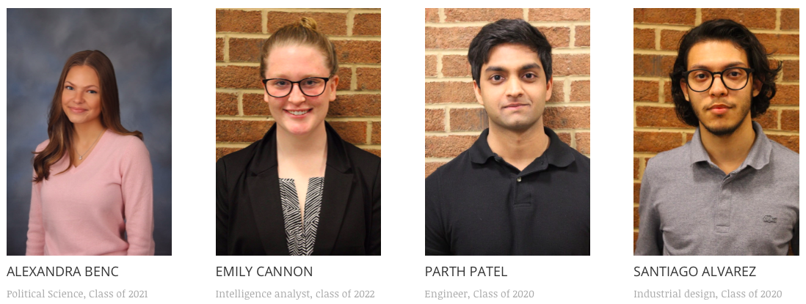
INTRODUCTION
Our soldiers in combat currently lack a recognition system for quick and accurate identification of lab equipment that may be weapons of mass destruction (WMD). At present, the Defense Threat Reduction Agency utilizes a mobile app equipped with Deep Learning Technology to process photographs of unknown laboratory equipment. Operational contexts and environmental factors, however, lower the accuracy of this process. Pontem's goal is to assist DTRA in creating a more efficient procedure to keep soldiers safe and informed.

Slide 3
THE PROBLEM
SUMMARY:
- The most efficient solution involves bridging both the soldiers and the decision process
- Need to get the identification process accuracy to ~90%
- The user needs a more interactive role in the application of the given technology
- Number of data sets currently available is not adequate
PAINS:
Significant risk in a quick, effective way to identify Weapons of Mass Destruction
Current algorithm: 30-70% accuracy
Lack of data and diversity in data
Clarity in images: connection or low quality
GAINS:
Get relevant and diverse data of equipment used to make WMD.
More accurate algorithm by improving the quality of the data obtained by the individuals.
Efficient and effective ways to identify WMD.
The individual will be more active on the process without having to be an expert.
Reduction costs.

Slide 4
MVP
Data acquisition system
Modified algorithm

Slide 5
