Slide 1
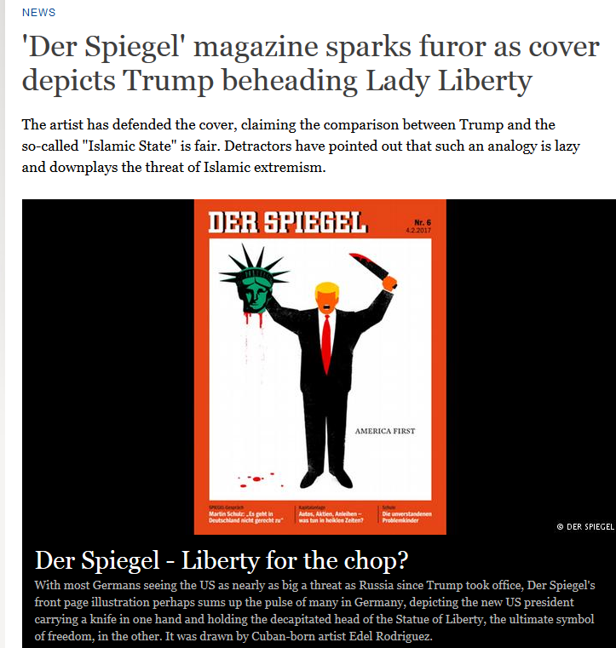

Slide 2
Hyper-nationalism
sense of national loss, national crisis, national victimhood
populism (a bottom-up movement that condemned elites)
anti-democratic AND democratic
forward looking BUT references an ideal imaginary past
glorifies war and violence
intensely masculine (male bonding; sexism and misogyny)
youthful dynamism
might-makes-right philosophy
all-powerful state
imperialist adventurism
paramilitarianism
The hallmarks of FASCISM

