Slide 1
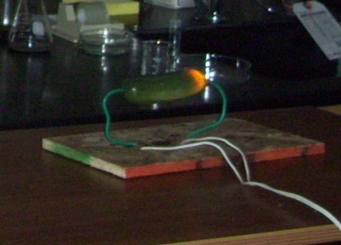
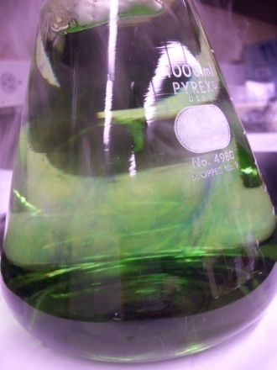
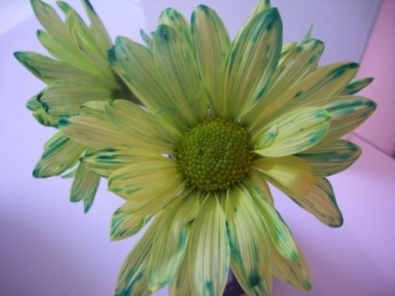

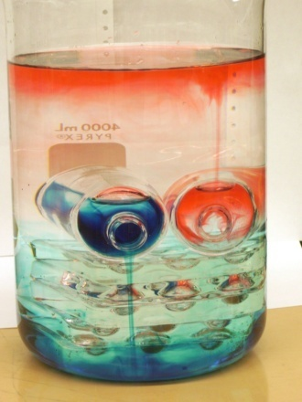
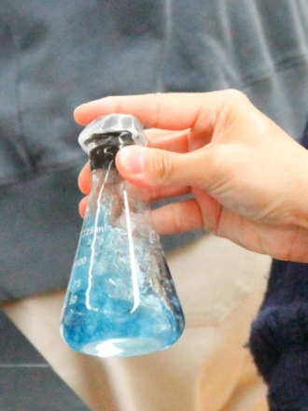
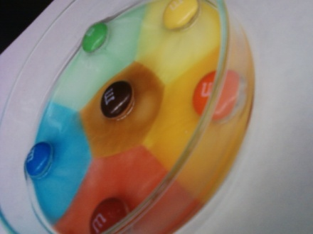

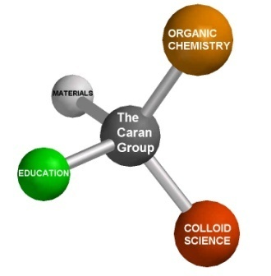
Website & Workshop: Catalysts for Science Educators
Casey Rogers
Kevin L. Caran
Dept. of Chemistry & Biochemistry

Slide 2
Overview
Background
ChemDemo Website
  Tour of site
  Videos
ChemDemo Workshop
  Evolution of the workshop (2010-present)
  Looking forward
Discussion

Slide 3
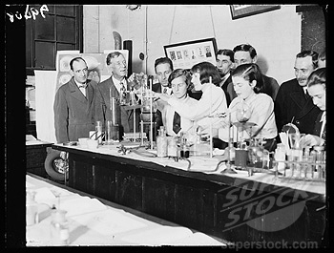
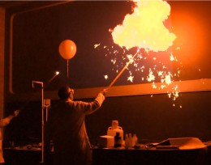
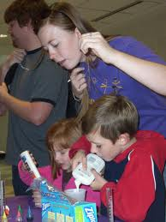
Origins
Long history of chemistry demonstrations @ JMU
Initial motivations for the project
  Expanding demonstration capacity in-house
  Resource for JMU professors & students

Slide 4
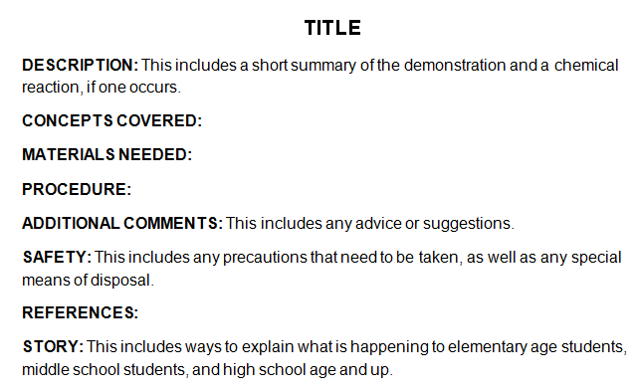
History of Project
(Spring 2010 – present)
Handouts were made for demonstrations used by the student organizations
Led to the idea of having them available online

Slide 5

EXPANDING OUR AUDIENCE
Cataloged demos
  Handouts made available online
Target Audience: VA Science Teachers
  Handouts made available online
  Demos linked via topics and SOLs
  Each demo has a Word handout for easy editing and printing
  Lesson plans and problem sets for selected demonstrations

Slide 6
: The Only Catalyst You’ll Ever Need
E_{a} (no catalyst)
E_{a} (with ChemDemo)
Before
Energy
After
Potential barriers to using demonstrations:
F = Find demo
SOL = determine relevance of demos to SOL
P = Prep demo
L = work into Lesson, develop lesson plan
E = finding ways to keep students Engaged
E_{a} (no catalyst) = F
+ SOL
+ P
+ L
+ E
E_{a} (with catalyst) = P
+
Notes:
Many times teachers feel the activation energy to overcome in order to do a demo is just too high. There is potentially a lot of work involved in doing a demo. As a teacher you have to determine which demo is suitable for the topic you are teaching, which SOL is the demo helping you teach? You have to find the time to prep the demo, and you have to have the chemicals to prep it with, you have to determine how your going to work in a demo when you’re already behind because of the 8 pointless snowdays your county had this semester, and most importantly: how are the students going to be engaged in this demo?
What we have done is try to lower the activation energy by doing much of the work for you. We have matched demos to topics and SOLs, so that takes out the first 2. We have given some ideas in our lesson plans section on how to incorporate the demo into a lesson so that it helps to teach the lesson, rather than being a tack on after you have taught the content. Finally we have made some problem sets that students can do to engage in the demo and make it really worthwhile. There is still an activation energy: you have to prep the demo, but it’s a lot lower than it was before.
6

Slide 7
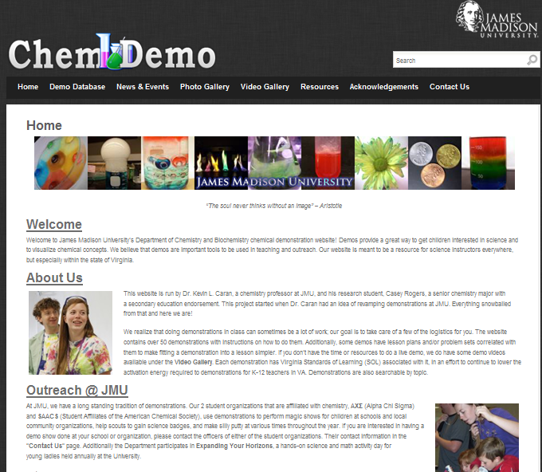
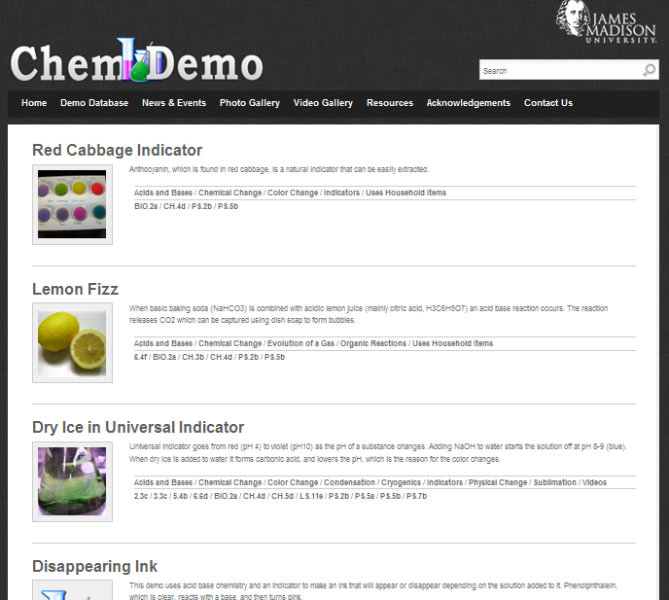
Website
http://sites.jmu.edu/chemdemo

Slide 8

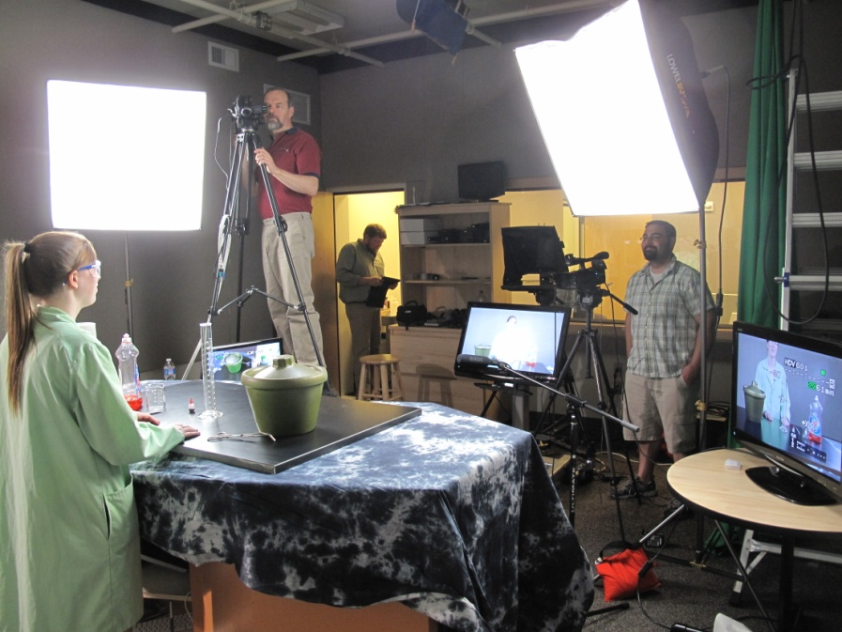
JMUChemDemo YouTube channel (http://www.youtube.com/user/JMUChemDemos/)

Slide 9
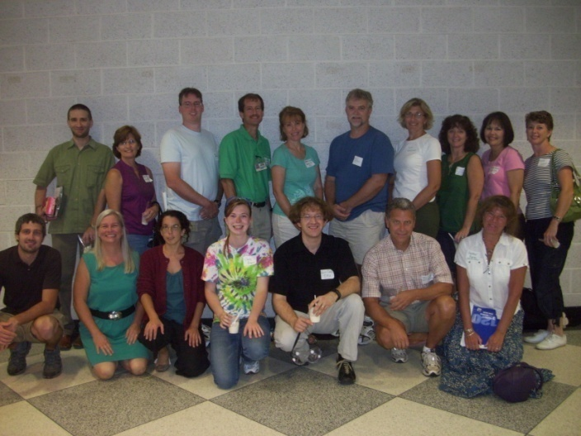
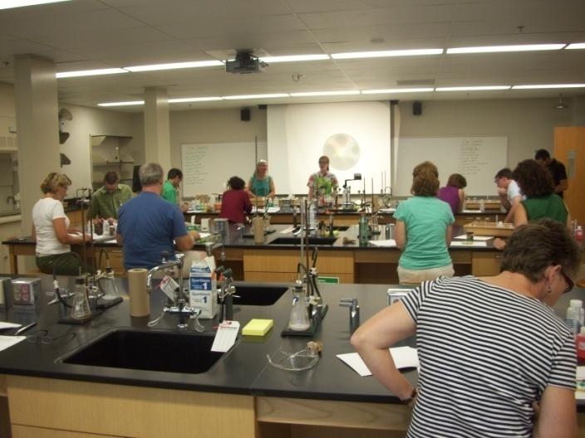
1st Annual Workshop
2010
July 20, 2010, 1:00 – 4:00 pm
12 teachers from VA and DC
Afternoon of demos followed by liquid nitrogen ice cream

Slide 10
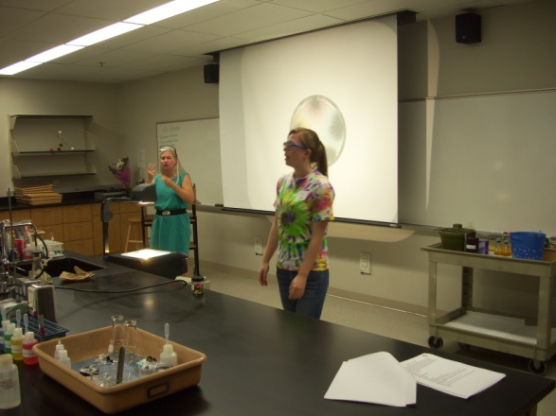
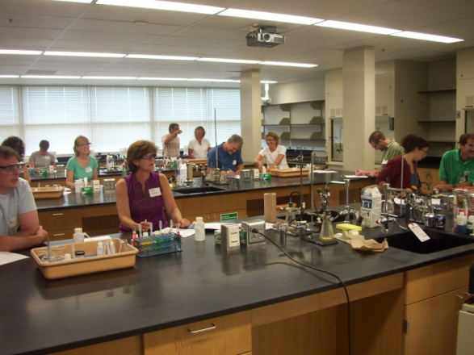
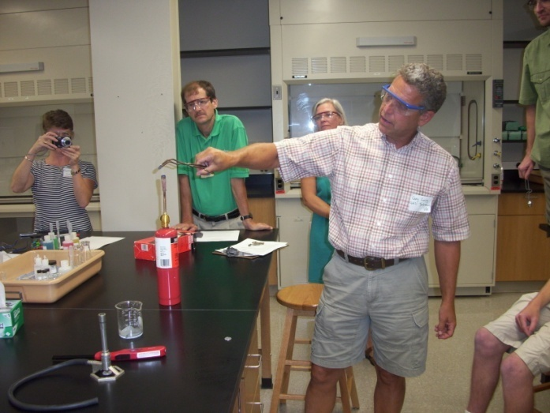
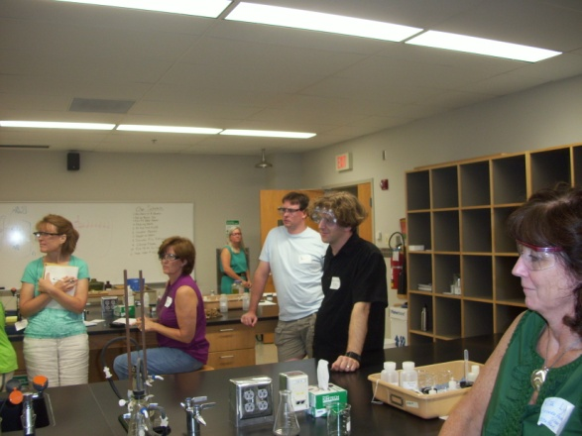
1st Annual Workshop
2010

Slide 11
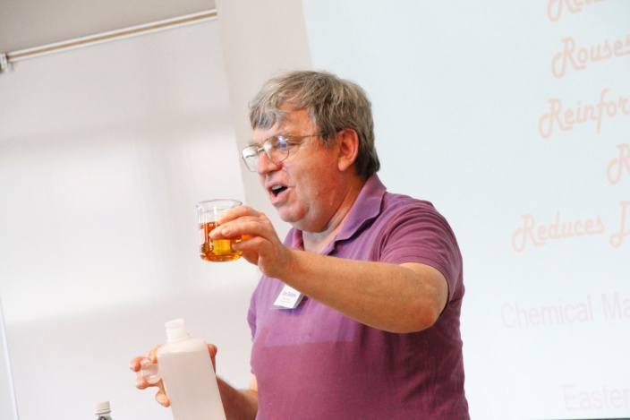
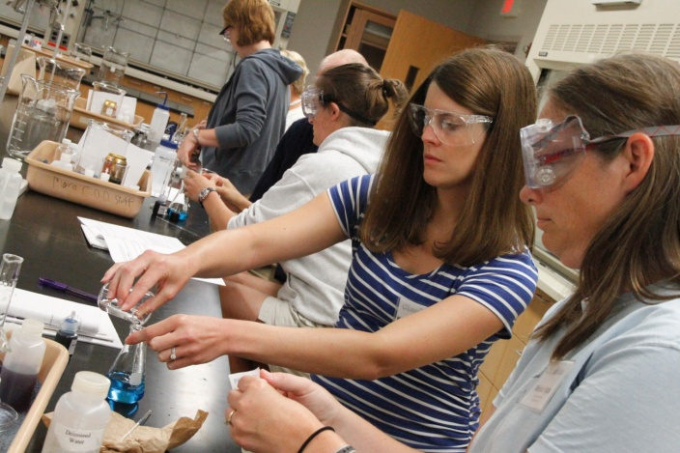
2nd Annual Workshop
2011
July 15, 2011, 9:00 am – 3:00 pm
Started with Keynote Presentation by Dr. Tom DeVore
Most of day was spent in the lab

Slide 12
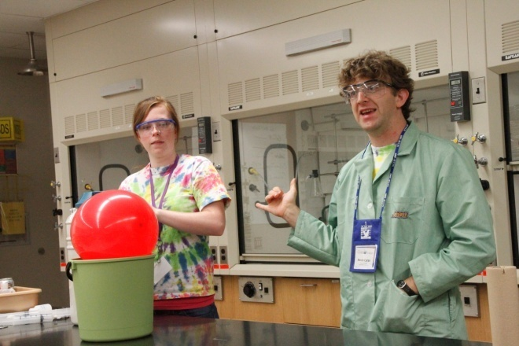
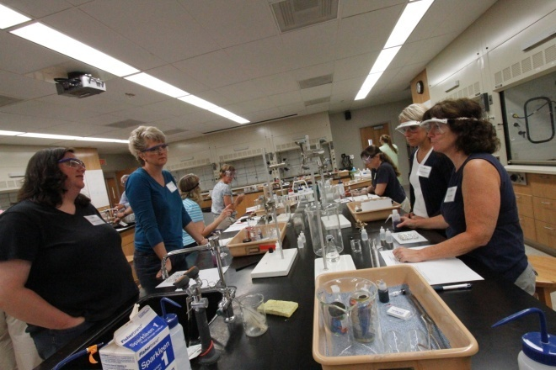
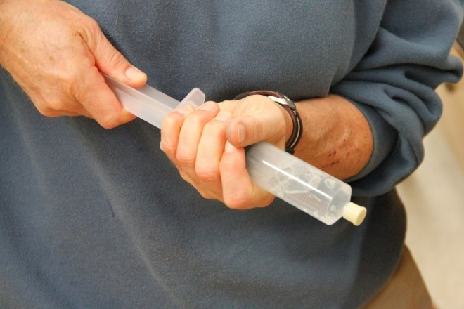
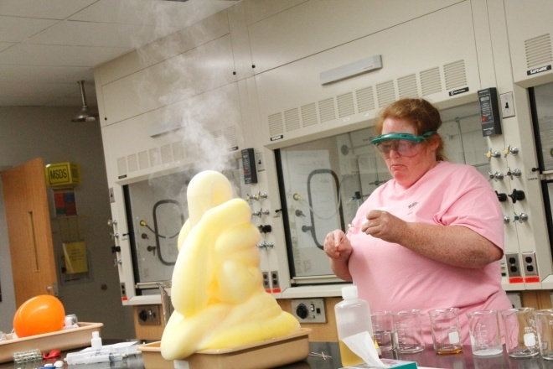
2nd Annual Workshop
2011

Slide 13
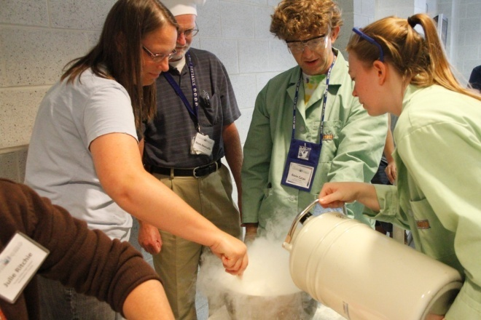
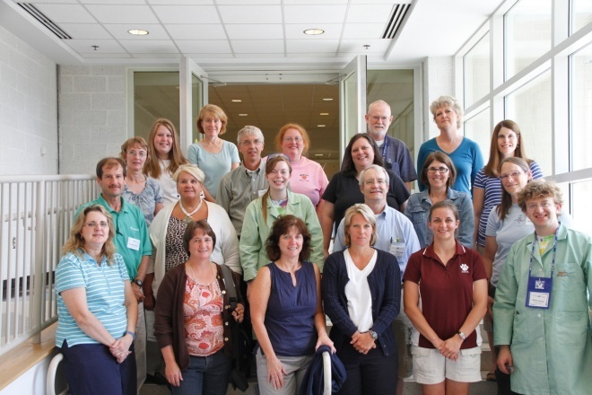
2nd Annual Workshop
2011
Finished day off with liquid nitrogen ice cream
Each participant got certificate of completion and DVD of videos

Slide 14
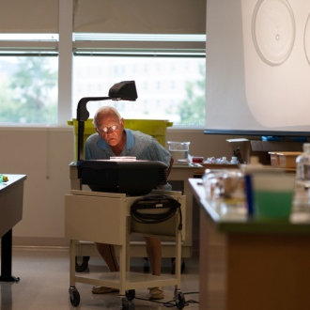
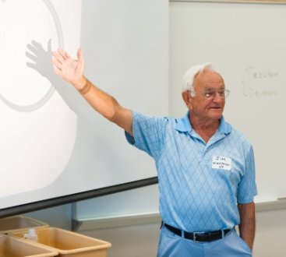
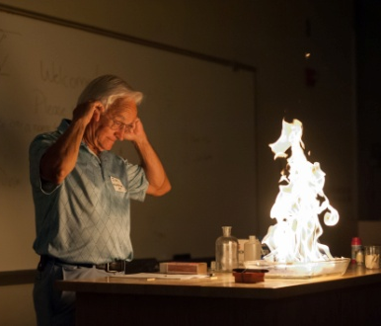
3rd Annual Workshop
2012
July 20th, 2012, 9:00 am – 3:00 pm
32 participants
Keynote address by Dr. Jim Wightman, VT Emeritus

Slide 15
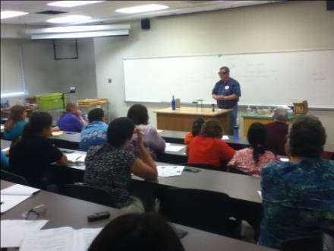
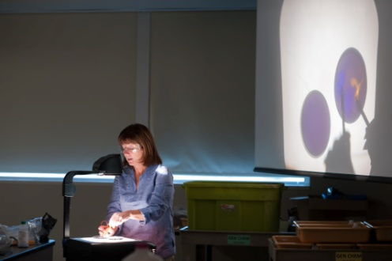
3rd Annual Workshop
2012
“Open Mic”
  Participants shared favorite demos
Lunch at campus dining hall

Slide 16
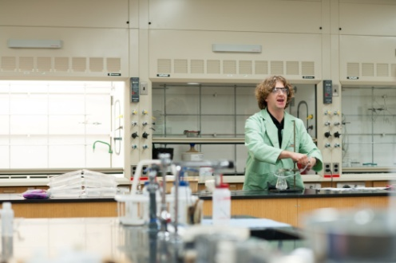
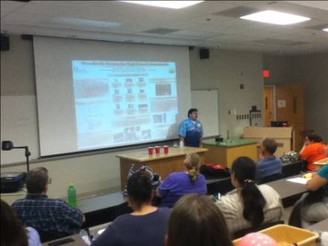
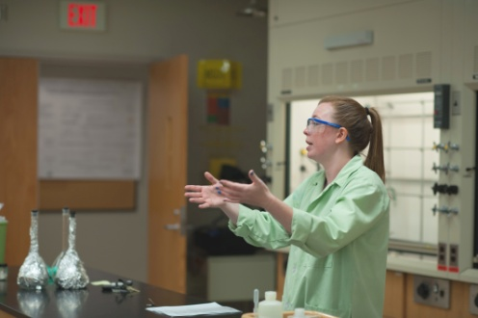
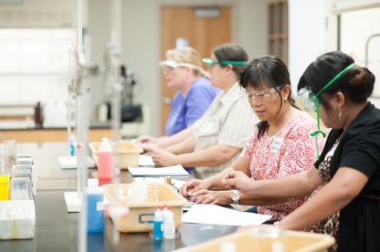
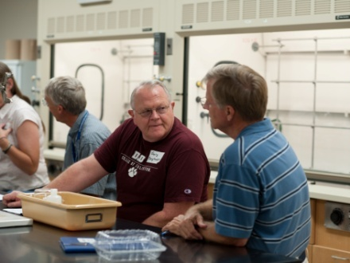
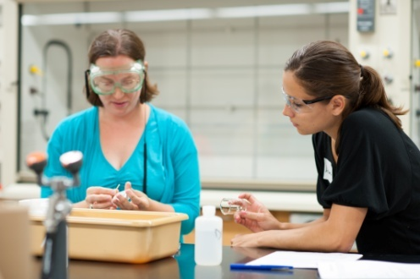
3rd Annual Workshop
2012
two 1 hour lab sessions

Slide 17
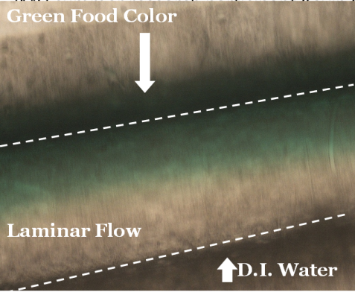
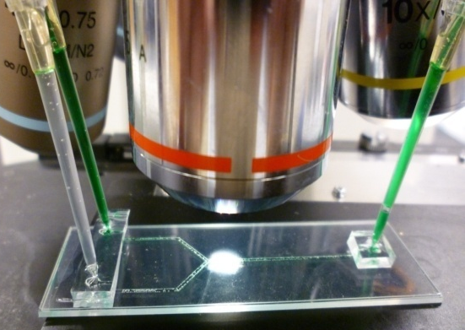
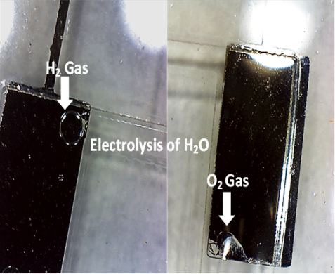
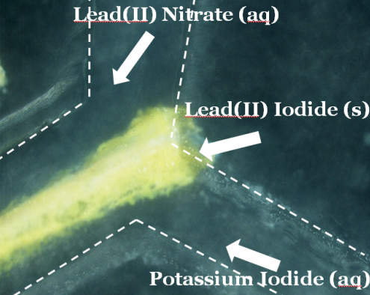
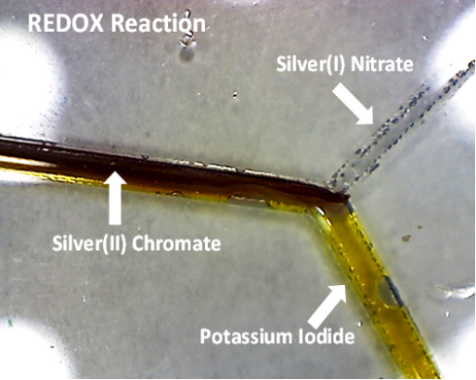
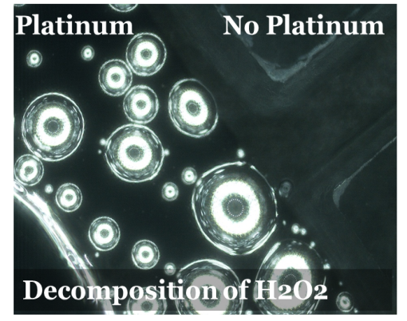
3rd Annual Workshop
2012
break between lab sessions to brainstorm about demos on a chip with high school teacher and JMU summer research participant Kevin Carini

Slide 18
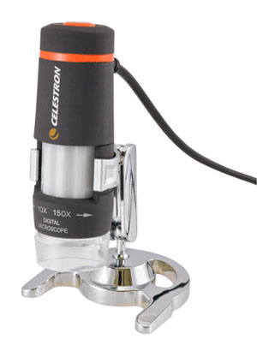
3rd Annual Workshop
2012
more brainstorming with a USB microscope
a tool that enables display of phenomena on a small scale

Slide 19


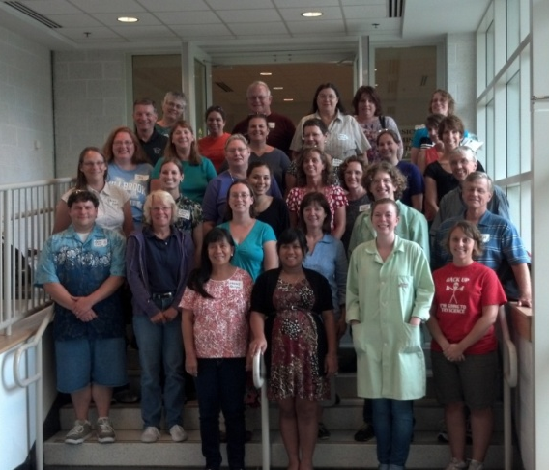
Workshop Attendance
2010
2011
2012
12 participants
11 schools
Afternoon only
20 participants
15 schools
All day
32 participants
28 schools
All day

Slide 20
Workshop Attendance

Slide 21
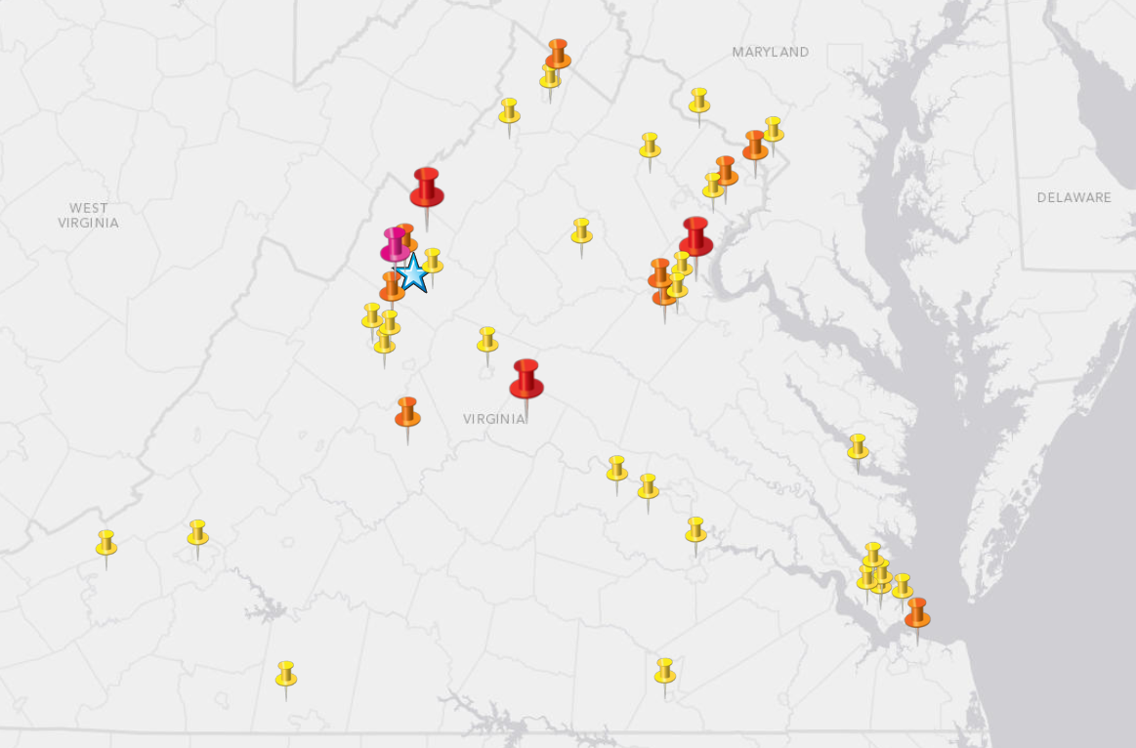
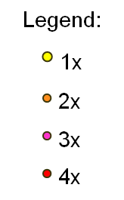
Workshops
Workshop Participants for 3 Years – School Locations

Slide 22
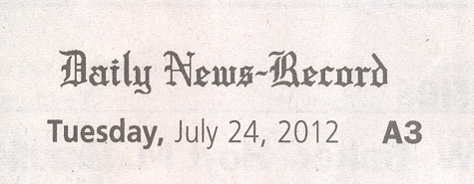



Slide 23
Future Work
Questions for Discussion
  Poll Everywhere
  Open Discussion
Collaborations
  Building website content
  Testing new demos
  Other ideas?

Slide 24

Support
We gratefully acknowledge the following for their generous financial support:
  Research Corporation for Scientific Advancement, Departmental Development Award 7957
  Jeffrey E. Tickle Family Endowment
  James Madison University Department of Chemistry and Biochemistry
  James Madison University College of Science and Mathematics (Dean's office)

Slide 25
Acknowledgments
Virginia High School Teachers
  Jill Barker, Millbrook H.S.
  Gary Long, Grafton H.S.
  Rita Lysher, Brooke Point H.S.
  Kevin Carini, Stuart Hall H. S.
Additional Support
  Dr. Barbara Reisner, JMU Chemistry Professor
  Dr. Tom DeVore, JMU Chemistry Professor
  Dr. Brian Augustine, JMU Chemistry Professor
  Dr. James Wightman, VT Chemistry Professor Emeritus
  Diane Elliott, Photography Services Manager
  D.Lee Beard, Center for Instructional Technology (video production)
  Kevin Hegg &Sufi Nawaz, Center for Instructional Technology (website)

Slide 26


Contact Us
http://sites.jmu.edu/chemdemo/
Casey Rogers
  rogersce@dukes.jmu.edu
Kevin L. Caran
  carankl@jmu.edu

