Slide 1
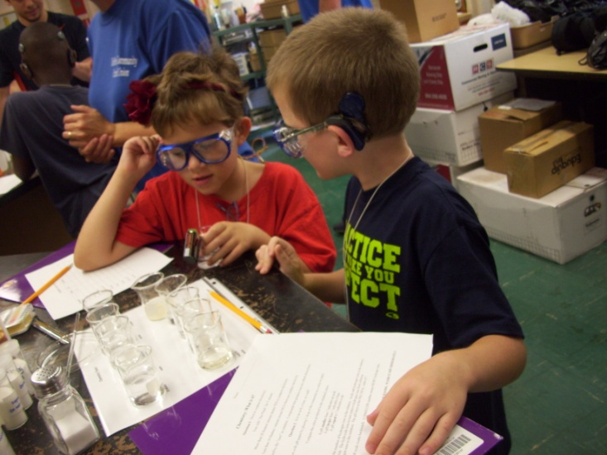
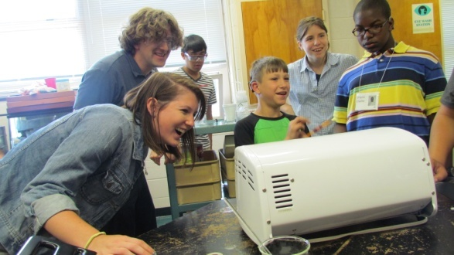
Week-Long Interactive Science Experience for Deaf Students
Casey Rogers

Slide 2
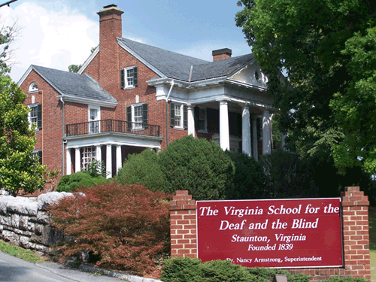
Why do a camp at VSDB?
Deaf and hard-of-hearing in STEM: 0.13-0.19%*
General population in STEM: 11-15.3%*
Our NSF funded REU has included Deaf professors, college and high school students for over 10 years
Wanted to do outreach to younger students to get them interested in science
*NSF 1996, 2004, 2009, 2011

Slide 3
VSDB Camp – "Trash to Treasure"
Collaborated with VSDB to put on camp June 25th – 29th
VSDB supplied 6 teachers
16 students ages 8-14; 2 age groups
REU involved including: professors, students and interpreters
Monday | Tuesday | Wednesday | Thursday
25 Lunch w/ Lundberg Afternoon w/ DeVore & Havey | 26 Afternoon w/ Downey & Hughey (@ Gypsy Hill Park) | 27 Afternoon w/ MacDonald & Caran | 28 All day @ JMU!

Slide 4
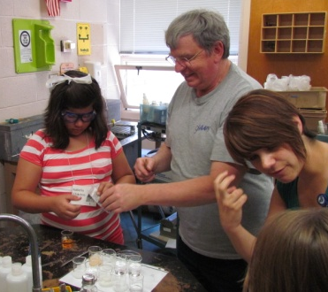
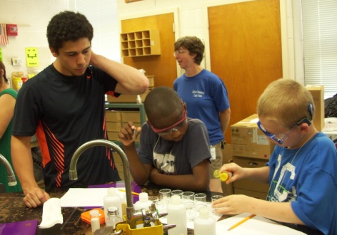
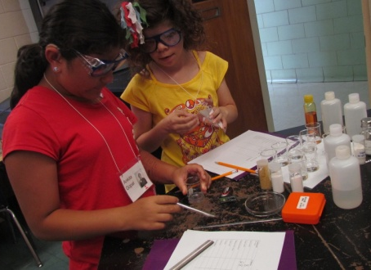
Monday
Dr. Lundberg & his students had lunch w/ VSDB students
DeVore – household substances in water: pH and conductivity?

Slide 5
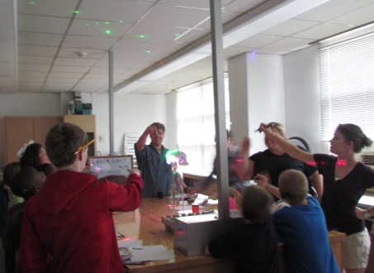
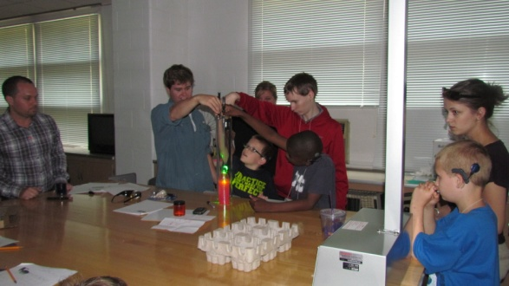
Monday
Havey – lasers on objects: reflection, scattering or absorption?

Slide 6
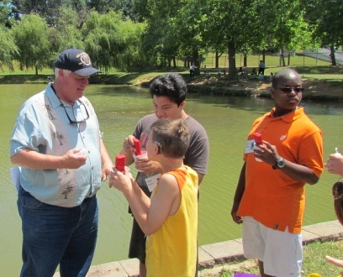
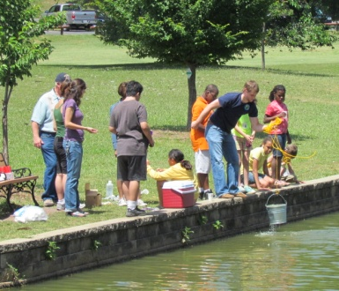
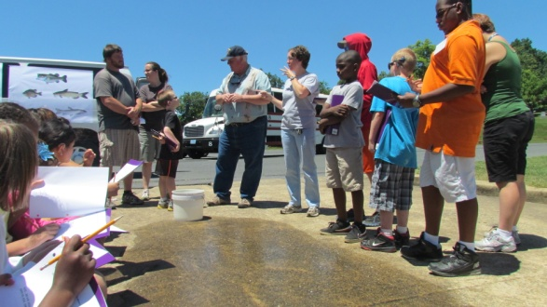
Tuesday
@Gypsy Hill Park
Downey – water quality: pH, temperature, and hardness?

Slide 7
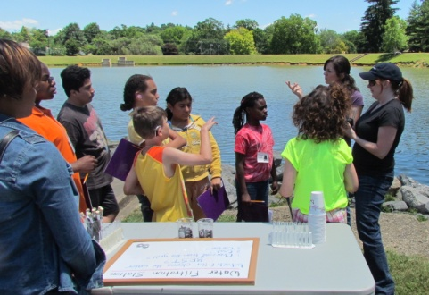
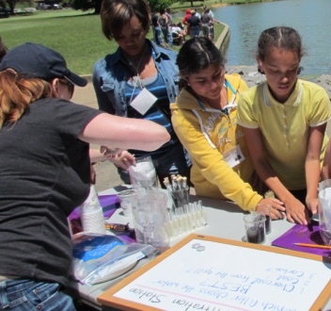
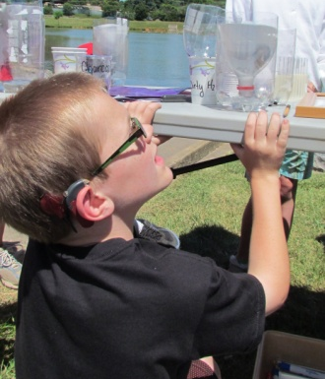
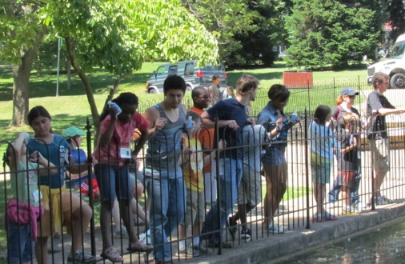
Tuesday
@Gypsy Hill Park
Hughey – cleaning up: water before and after filtering? Turbidity?

Slide 8
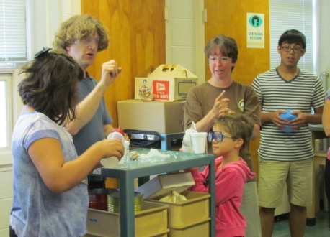
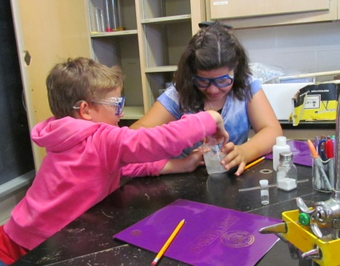
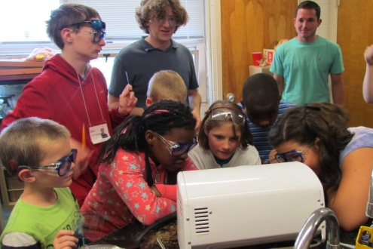
Wednesday
Caran – polymers: what are they?

Slide 9
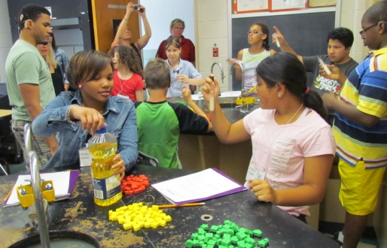
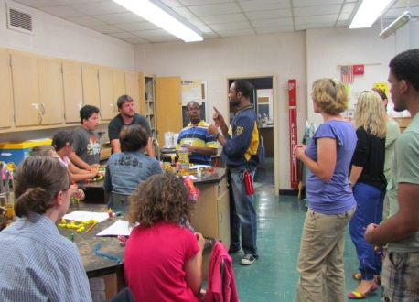
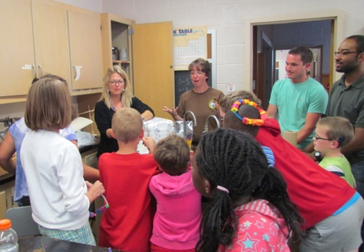
Wednesday
MacDonald – proteins: what are they? How do they fold?

Slide 10
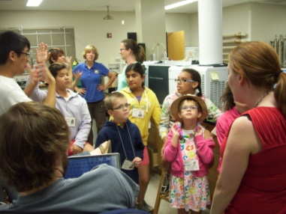
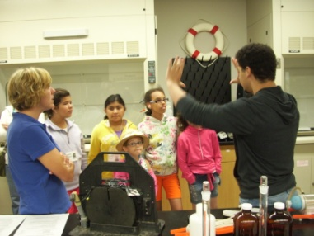
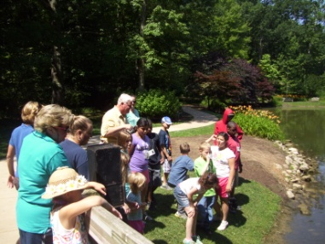
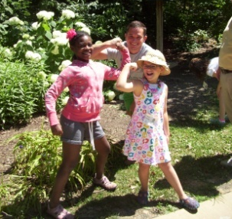
Thursday
@JMU
Lab Tours
Arboretum

Slide 11
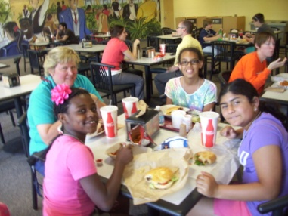
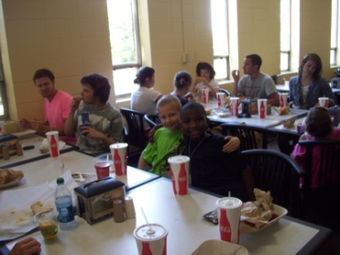
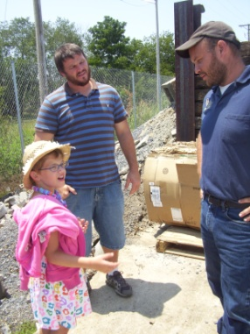
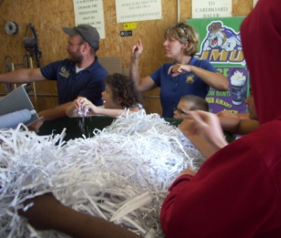
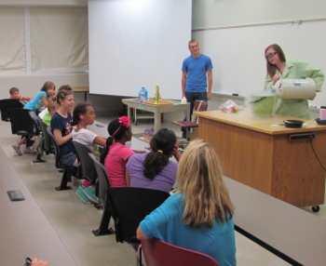
Thursday
@JMU
Lunch
Recycling Center
Magic Show

Slide 12
Involvement
JMU professors
(Chem + CSD)
JMU Students (Chem + CSD)
Deaf high school teachers
High school Deaf students
Outside college students (Deaf and Hearing)
Interpreters
VSDB &
Pre-College Students

Slide 13
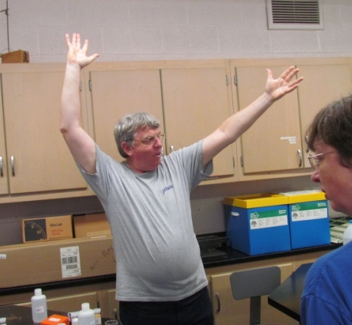
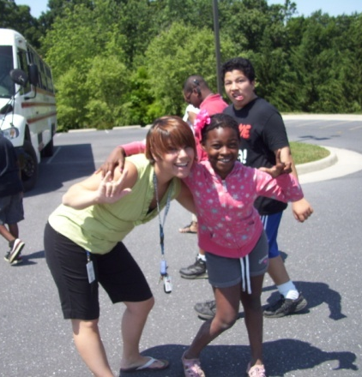
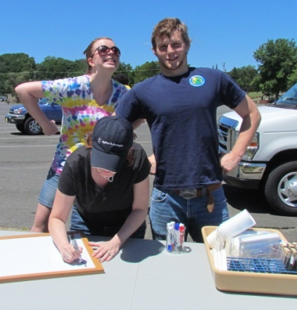
Future of this Outreach
Continue outreach to younger Deaf students
Plan to do this camp again next summer w/ VSDB
Possibility: camps at other schools in other states

Slide 14
Acknowledgments
Dr. Kevin Caran
Dr. Tom DeVore
Dr. Dan Downey
Dr. Dan Havey
Dr. Chrisi Hughey
Dr. Dan Lundberg
Dr. Gina MacDonald
NSF #CHE-1062629
Departmental Development Award 7957
Department of Chemistry and Biochemistry
College of Science and Mathematics

