Slide 1
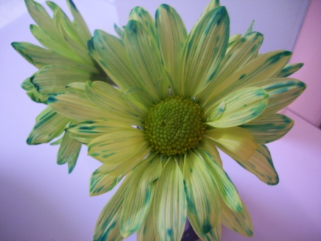
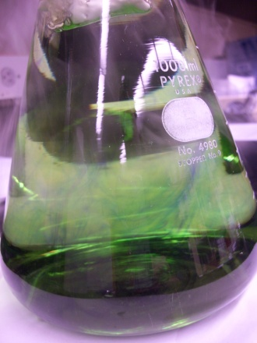

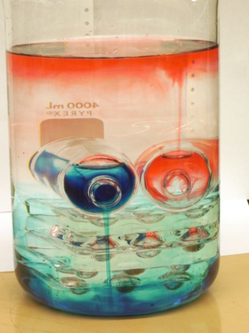
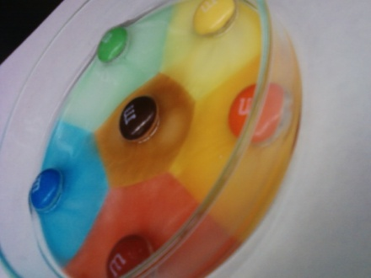

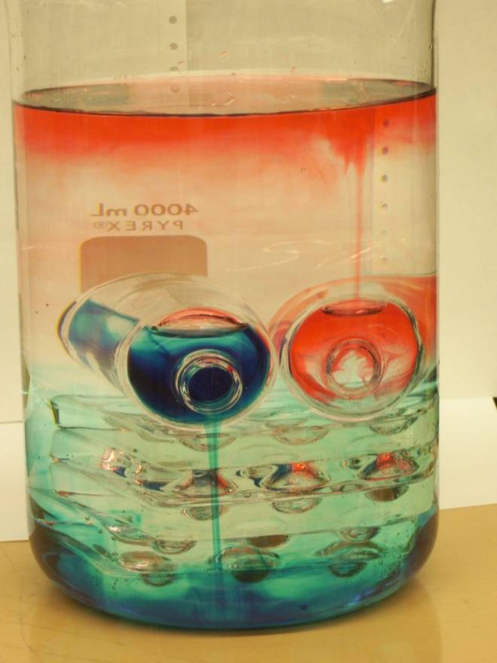
JMU : lowering the activation energy to do chemistry demonstrations
Casey Rogers
Kevin L. Caran
Dept. of Chemistry & Biochemistry

Slide 2
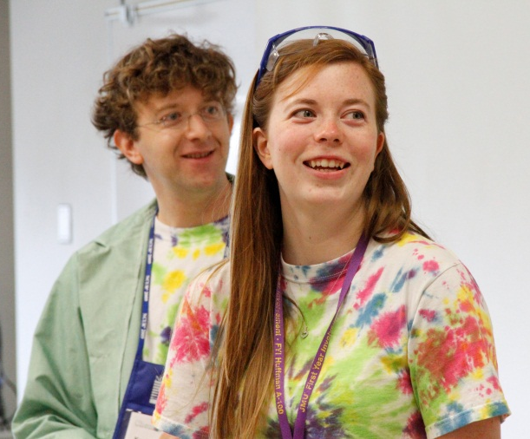
Outline
Introduction
Website
Videos
Workshop
Future Work

Slide 3
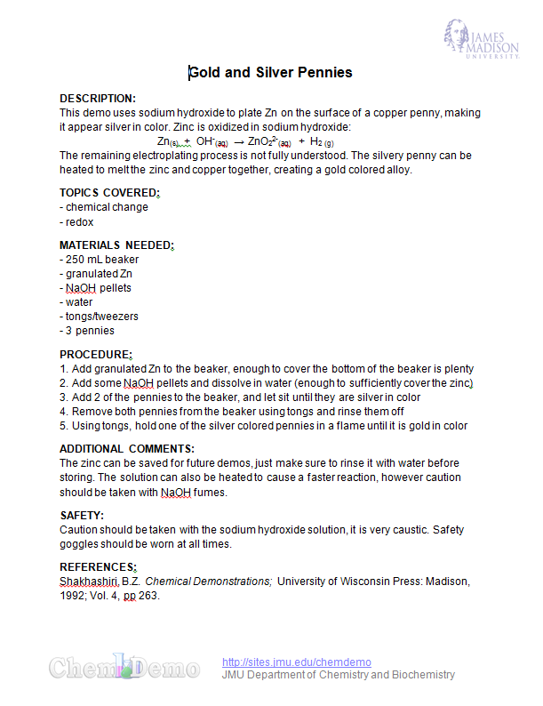
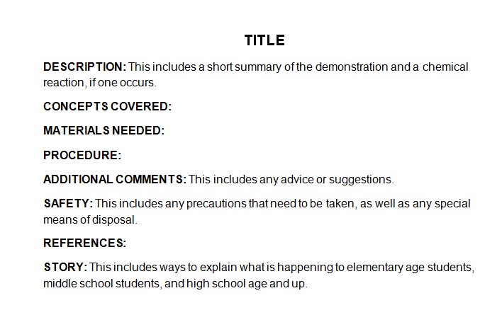
Beginning of Project
Handouts were made for demonstrations used by the student organizations
Led to the idea of having them available online

Slide 4
Our Website
http://sites.jmu.edu/chemdemo
Aim is to be a chemical demonstration resource
50+ demos
Demos include topics and VA SOLs covered
Each demo has a Word handout for easy editing and printing
Lesson plans and problem sets for selected demonstrations

Slide 5
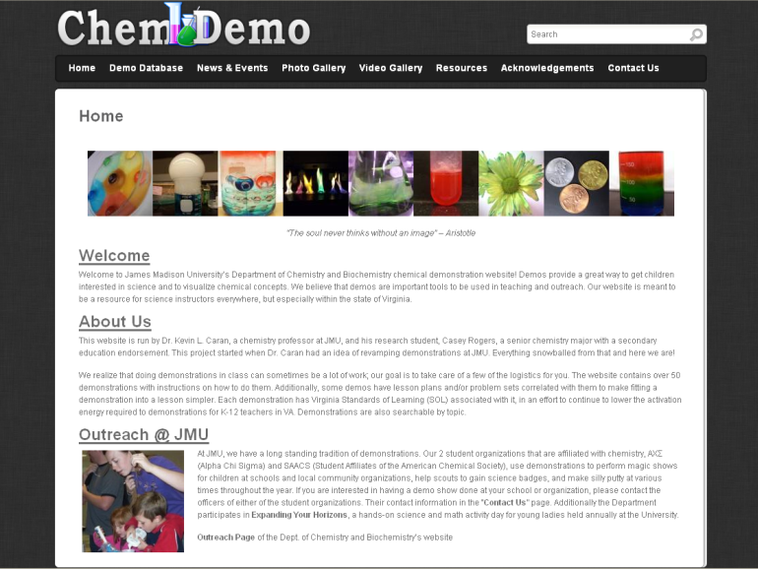
Our Website
http://sites.jmu.edu/chemdemo

Slide 6
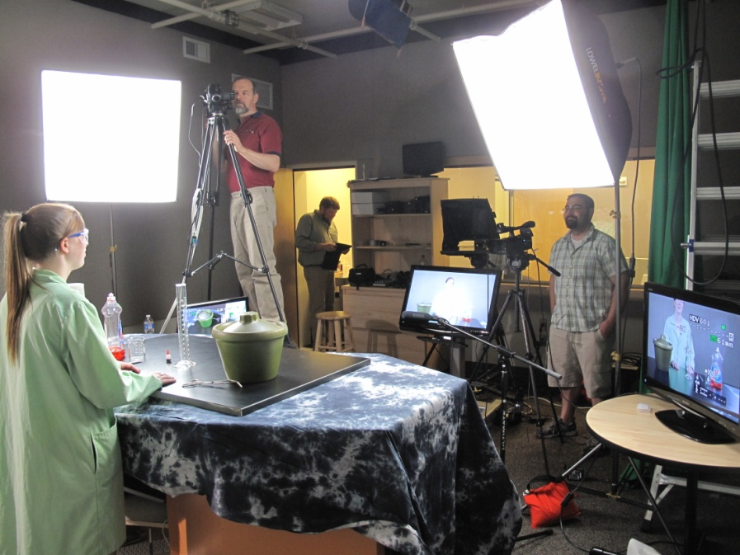
Demonstration Videos
http://www.youtube.com/user/JMUChemDemos/
Teachers had asked for demonstration videos
Filmed demos that may be difficult for teachers to do
  Liquid nitrogen, dry ice, requires hood, etc.

Slide 7
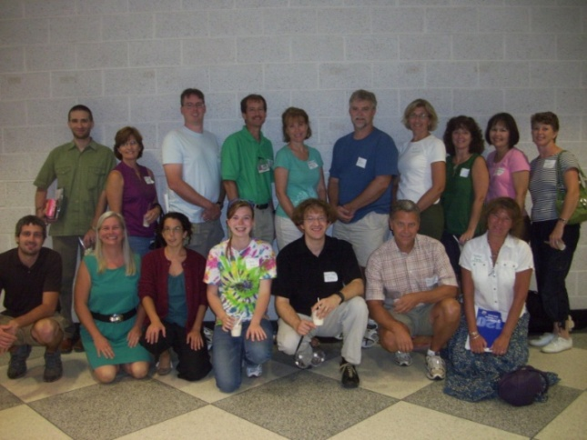
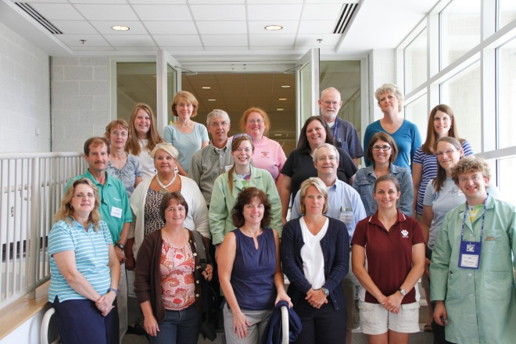
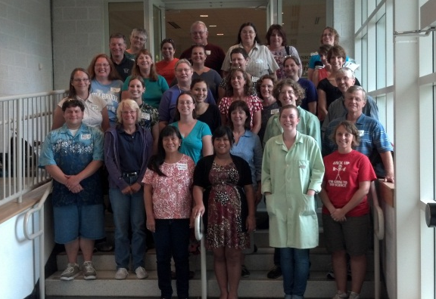
Annual Workshop
Held workshops: Summers 2010, 2011 & 2012
Participants receive hands-on demo instruction
Get to share demos, variations, & ideas with peers
2010 – 12 participants
2011 – 19 participants
2012 – 32 participants

Slide 8
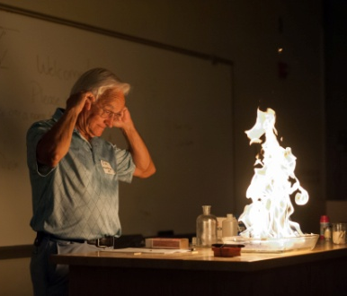
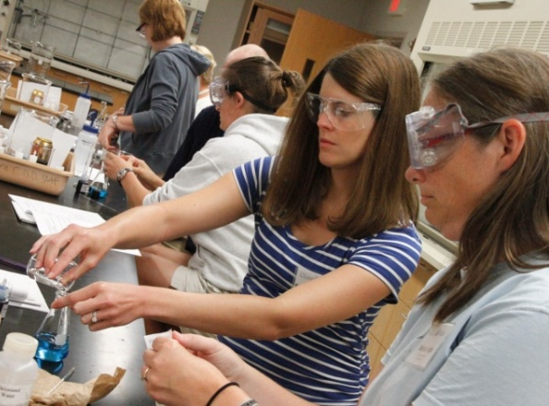
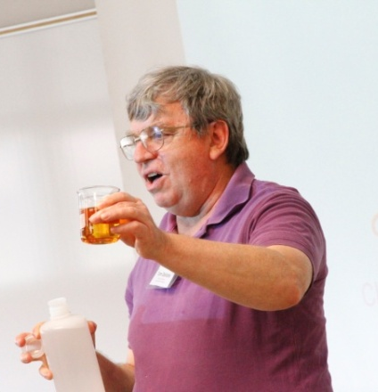
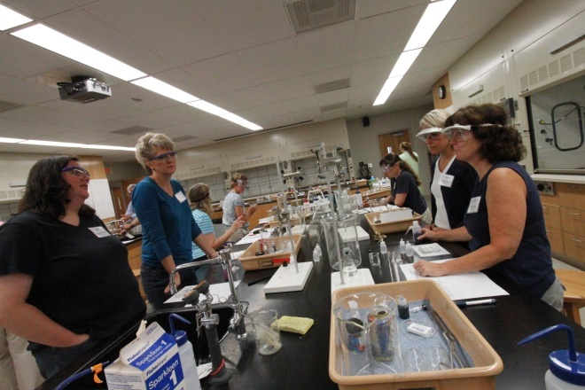
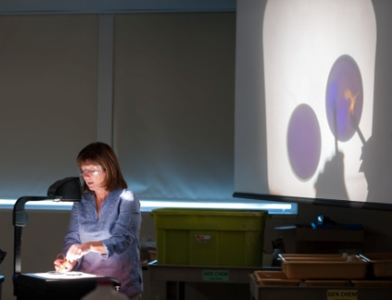
Workshop Highlights

Slide 9
Annual Workshop
Year | # of Participants
2010 | 12
2011 | 19
2012 | 32
>360!

Slide 10
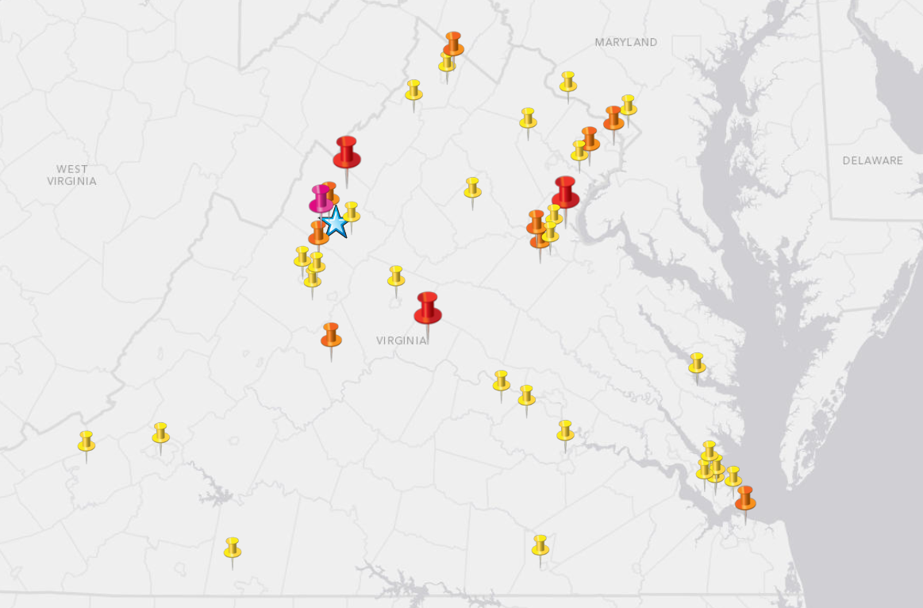
Workshops
Workshop Participants
for 3 Years – School Locations
Legend:
• 1x
• 2x
• 3x
• 4x
53 teachers
40 schools

Slide 11
Future Work
Virginia Association of Science Teachers’ (VAST) Professional Development Institute in November
Holding additional workshops, and continuing to expand the website
Transitioning to more collaborative efforts between JMU Chemistry and secondary school teachers
  Teachers add demos?
  Ability to share variations/comments?
  Teacher-led workshop sessions?

Slide 12

Acknowledgments
  Jeffery E. Tickle Family Endowment
  Dr. Barbara Reisner
  JMU Photography Services
  D.Lee Beard
  Dr. James Wightman
  Kevin Hegg & Sufi Nawaz
  Kevin Carini & Dr. Brian Augustine
  Dr. Tom DeVore
Departmental Development Award 7957
Department of Chemistry and Biochemistry
College of Science and Mathematics

Slide 13
Questions
?
?
?
?
?
?
?

